Slide 1



A BERT-BASED APPROACH FOR SENTIMENT ANALYSIS OF STUDENT FEEDBACK

Slide 2


INTRODUCTION
The student voice, found in open-ended survey comments, is a critical component for institutional improvement.
Many institutions are "data-rich" but "insight-poor," struggling to analyze large volumes of unstructured textual feedback.
Manual review is labor-intensive, inconsistent, and biased.
Natural Language Processing (NLP) offers a scalable, automated solution to this challenge.
This project will apply a state-of-the-art BERT (Bidirectional Encoder Representations from Transformers) model to analyze 49,812 student feedback records from JRU.
This work supports UN SDG 4 (Quality Education) and SDG 16 (Strong Institutions).

Slide 3
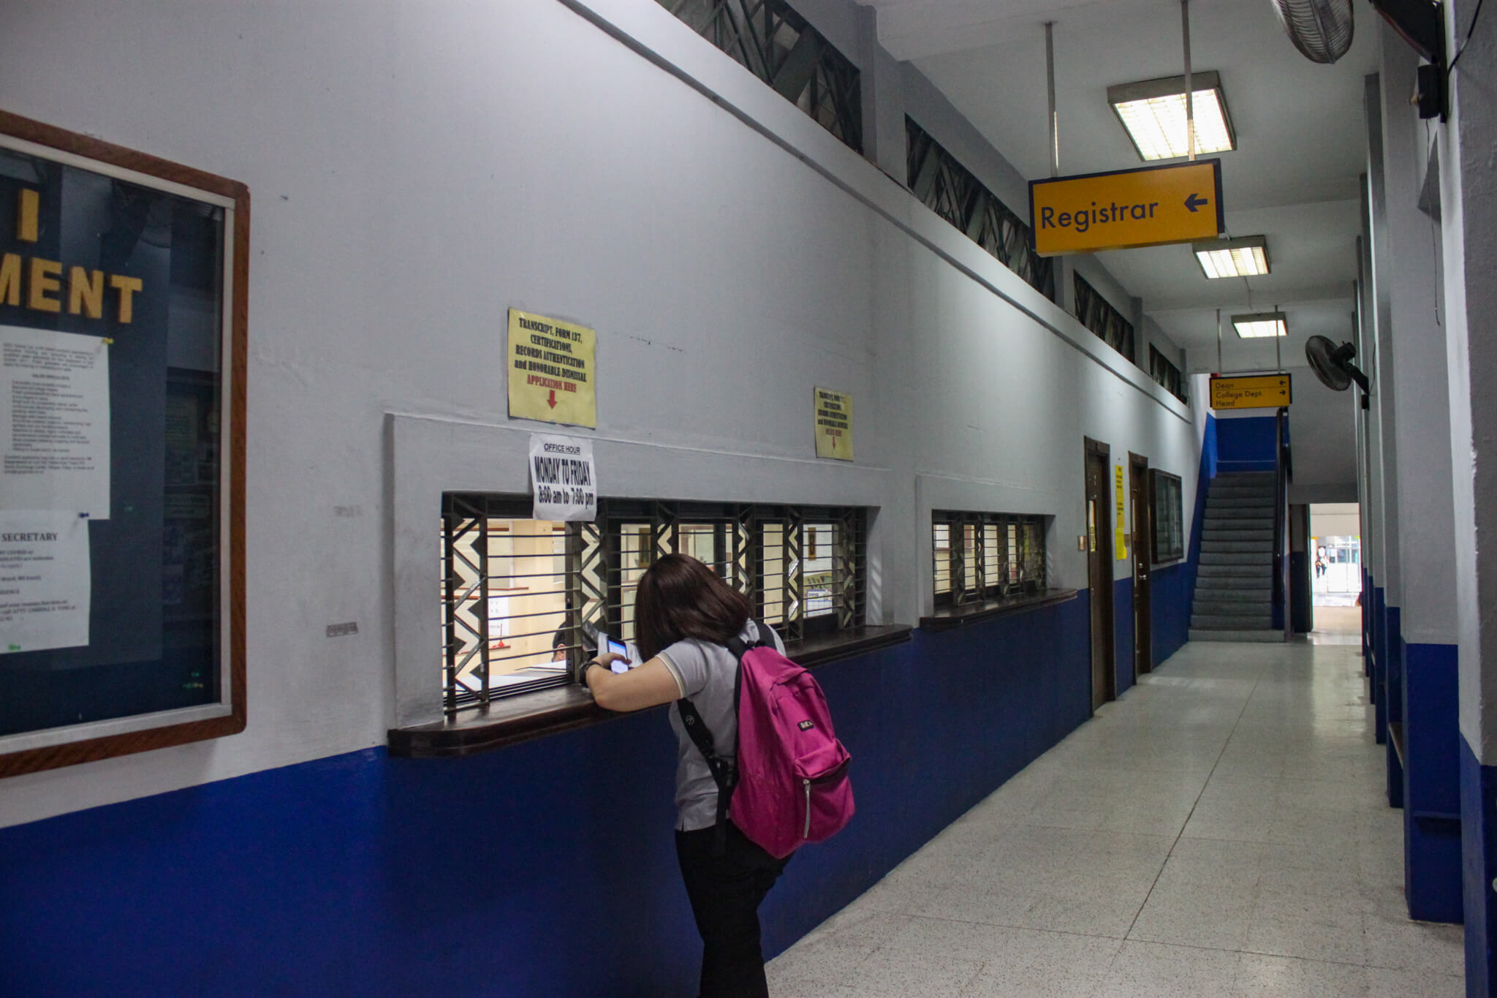
PROBLEM STATEMENT
The Core Problem: The sheer volume (~49,812 records) of open-ended "Suggestions" makes manual analysis an unsustainable and resource-prohibitive task.
Linguistic Complexity: The feedback features significant code-switching between English and Taglish.
This mixed-language text is a major hurdle for traditional, lexicon-based analysis methods which fail to interpret its nuances.
The Impact: This creates a critical gap between data collection and actionable insight, hindering agile, data-informed decision-making by the administration.

Slide 4
OBJECTIVES
01
To implement and train baseline sentiment classification models using a traditional machine learning pipeline (TF-IDF vectorization with Logistic Regression) and spaCy’s default Bag-of-Words or embedding-based classifier.
02
To fine-tune a pre-trained, transformer-based BERT model for the specific task of sentiment classification on the prepared JRU student feedback dataset.
03
To conduct a rigorous, comparative evaluation of the fine-tuned BERT models against the baseline models using a comprehensive set of performance metrics (Accuracy, Precision, Recall, and F1-Score).

Slide 5




REVIEW OF RELATED LITERATURE
Sentiment Analysis is Proven: It's a valuable tool in higher education for identifying specific service issues that quantitative data can miss.
Models Have Evolved:
Traditional methods (TF-IDF) are fast but ignore context. SpaCy’s text categorizer uses embeddings to capture some semantic meaning and nuance.
BERT represents a paradigm shift, understanding deep context by analyzing the entire sentence at once, achieving state-of-the-art results.
BERT Solves the "Taglish" Challenge:
Standard models fail on code-switched text. Research shows that fine-tuning multilingual BERT models is the most effective strategy for accurately interpreting mixed-language feedback like that found at JRU.

Slide 6

METHODOLOGY OVERVIEW
Data Preparation:
Model Comparison:
Evaluation:
Preprocessing: Applied a standard text-cleaning pipeline (lowercasing, punctuation removal, etc.).
Ground Truth Creation: Manually annotated 3,043 comments (Positive, Negative, Neutral) with quality checks to create a reliable dataset.
Dataset Split: Models were trained on training set, a validation set, and a test set.
Metrics: Rigorous comparison using Accuracy, Precision, Recall, and F1-Score to determine the superior model.
Baseline Model 1: TF-IDF with Logistic Regression.
Baseline Model 2: spaCy's default pipeline.
Primary Model: Fine-Tuned Multilingual BERT.

Slide 7

EXPECTED OUTCOME
Tangible Deliverables:
A fine-tuned BERT model that accurately classifies sentiment in JRU's mixed-language feedback.
An annotated dataset of 3,043 comments for future research.
Strategic Contribution:
A proof-of-concept and IEEE report demonstrating that automating feedback analysis is viable at JRU.
A clear foundation for the university to adopt a more agile, data-informed approach to institutional improvement.

Slide 8

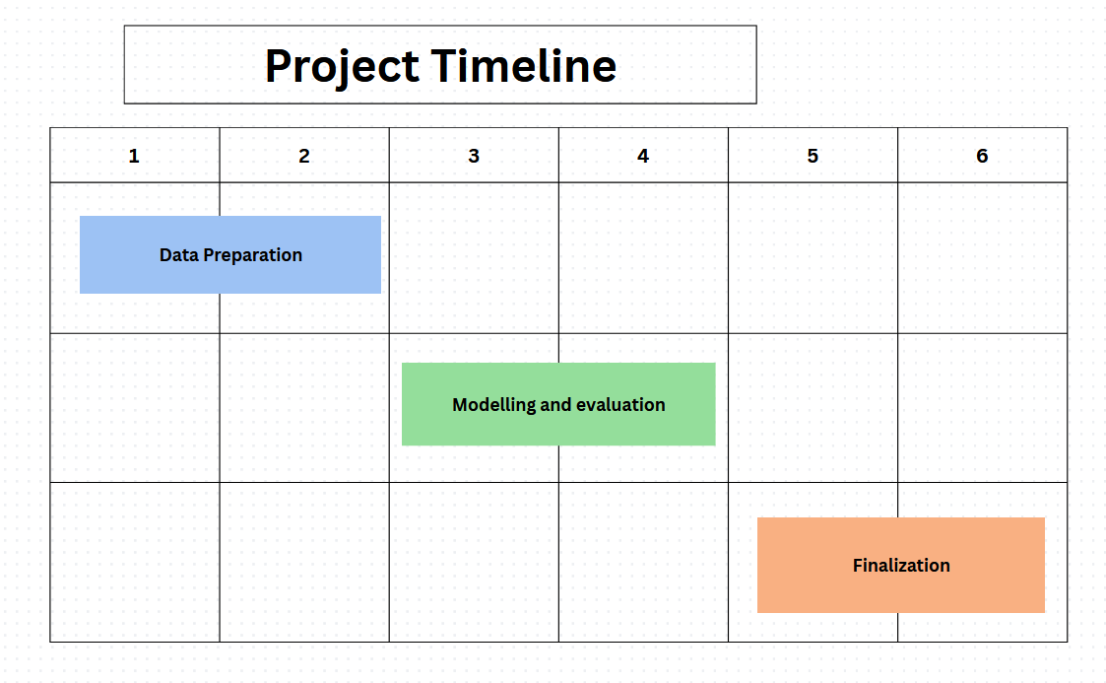



Week 5: Finalization
Final testing, documentation, and report writing.
Preparation of the final presentation and demo.
Weeks 3–4: Modeling and Evaluation
Implementation, training, and fine-tuning of all three models.
Comparative evaluation on the test set.
Weeks 1–2: Data Preparation
Data collection, annotation, exploration, and preprocessing.

